Slide 1
GraphQL
Banuprakash C

Slide 2
What is GraphQL?
GraphQL is a query language and a server-side runtime (typically served over HTTP).
GraphQL is a language for querying data.
Unlike most query languages (such as SQL), you don’t use GraphQL to query a particular type of data store (such as a MySQL database).
Instead, you use GraphQL to query data from any number of different sources.

Slide 3
Key features of GraphQL
Performance
Prevents over-fetching:
In traditional approaches like REST, you often end up over-fetching — asking for more data than you need.
With GraphQL, you can ask for exactly what you need. The benefit is reduced bandwidth, which may be especially important on mobile and low-energy devices.
Prevents under-fetching (multiple round-trips):
The other end of the fetching problem in REST is not getting all the data you need in a single round-trip.
Consider fetching your friends list in a social media app and needing to batch individual queries to get each friend’s profile picture. GraphQL helps solve this problem.

Slide 4
Key features of GraphQL
Developer experience
Hierarchical & declarative:
GraphQL data is inherently graphical and declarative. This makes your queries easier to understand and your data easier to work with. By nesting, we can ask for related data, keeping queries cohesive, and spending zero time stitching together multiple responses like we sometimes have to do with REST.
Strongly typed (stable API):
GraphQL is strongly typed. This means a more stable API with fewer bugs in development and introduces the possibility of more intelligent tooling.
GraphQL versioning:
GraphQL favors the notion of a single, incrementally developed graph. You can give deprecation hints when you add, remove, and change fields on your existing graph. Compare this to the coarse-grained approach to versioning in a REST context with version numbers across an entire API.

Slide 5
Key features of GraphQL
Architecture
Decouples the client from the server:
UI developers don’t need to wait for backend teams to build an API first.
A GraphQL schema acts as a contract for front-end app devs to start building (by mocking out the API calls) and leaves backend teams to deliver on the contract by building the underlying services that serves the graph.
Single source of truth:
UI developers only need to know about to a single endpoint to access the entirety of the data behind a company’s graph.
Scalable with Federation:
GraphQL fits nicely into a microservice architecture using an approach called Federation. Federation enables backend teams to maintain their own sub-graphs and compose them into a single graph for an entire organization.
Introspection:
Introspection provides the framework for all kinds of great tooling. There exist tools to auto-generate API docs and TypeScript types for your resolvers and queries.

Slide 6
Key features of GraphQL
Community
GraphQL is currently being used by a large number of notable companies including GitHub, PayPal, Glassdoor, Shopify, Twitter, The New York Times, Expedia, etc.

Slide 7
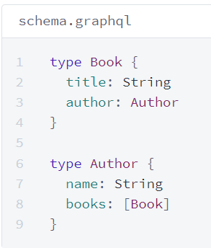
GraphQL Schema (SDL)
The schema defines how clients can retrieve and data from your GraphQL API.
With schemas, you can easily shape and evolve your data to fit your specific business, product, or project needs.
A schema defines a collection of types and the relationships between those types.

Slide 8
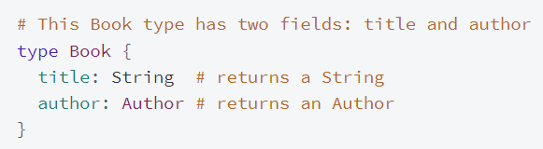
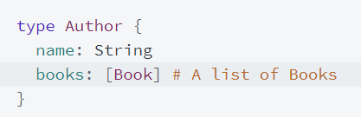
GraphQL Schema (SDL)
Field definitions
Most of the schema types you define have one or more fields:
List fields
A field can return a list containing items of a particular type.

Slide 9
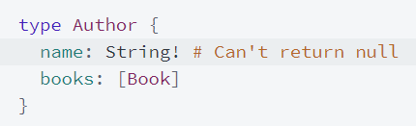

GraphQL Schema (SDL)
Field nullability
By default, it's valid for any field in your schema to return null instead of its specified type. You can require that a particular field doesn't return null with an exclamation mark !

Slide 10
GraphQL Schema (SDL)
Types
Scalar
Object
Input
Enum
Union
Interface

Slide 11
GraphQL Schema (SDL)
Scalars
The graphql specification says that all implementations must have the following scalar types.
String aka GraphQLString - A UTF‐8 character sequence.
Boolean aka GraphQLBoolean - true or false.
Int aka GraphQLInt - A signed 32‐bit integer.
Float aka GraphQLFloat - A signed double-precision floating-point value.
ID aka GraphQLID - A unique identifier which is serialized in the same way as a String; however, defining it as an ID signifies that it is not intended to be human‐readable.
graphql-java adds the following scalar types which are useful in Java based systems
Long aka GraphQLLong - a java.lang.Long based scalar
Short aka GraphQLShort - a java.lang.Short based scalar
Byte aka GraphQLByte - a java.lang.Byte based scalar
BigDecimal aka GraphQLBigDecimal - a java.math.BigDecimal based scalar
BigInteger aka GraphQLBigInteger - a java.math.BigInteger based scalar
The class graphql.Scalars contains singleton instances of the provided scalar types

Slide 12
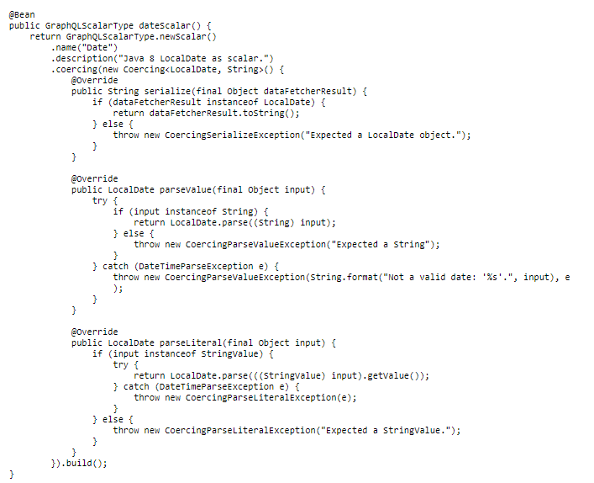
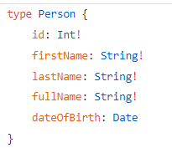
GraphQL Schema (SDL)
Custom Scalars
scalar Date

Slide 13
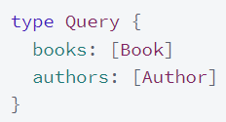
GraphQL Schema (SDL)
The Query type
The Query type is a special object type that defines all of the top-level entry points for queries that clients execute against your server.
Each field of the Query type defines the name and return type of a different entry point.
This Query type defines two fields: books and authors. Each field returns a list of the corresponding type.
With a REST-based API, books and authors would probably be returned by different endpoints (e.g., /api/books and /api/authors).

Slide 14
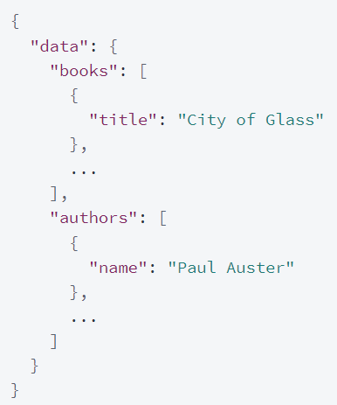
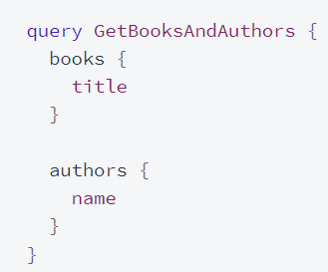
GraphQL Schema (SDL)
Structuring a query
When your clients build queries to execute against your graph, those queries match the shape of the object types you define in your schema.
Client | Server responds

Slide 15
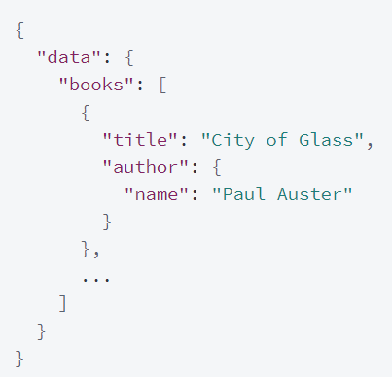
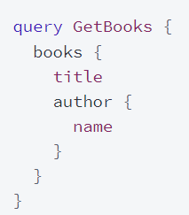
GraphQL Schema (SDL)
Structuring a query
Because our schema's Book type has an author field of type Author, a client could instead structure their query like so:

Slide 16
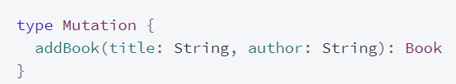
GraphQL Schema (SDL)
The Mutation type
The Mutation type is similar in structure and purpose to the Query type. Whereas the Query type defines entry points for read operations, the Mutation type defines entry points for write operations.
This Mutation type defines a single available mutation, addBook.
The mutation accepts two arguments (title and author) and returns a newly created Book object. As you'd expect, this Book object conforms to the structure that we defined in our schema.

Slide 17
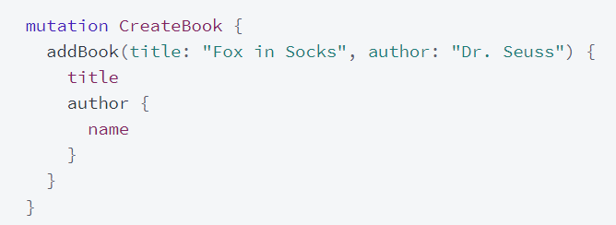
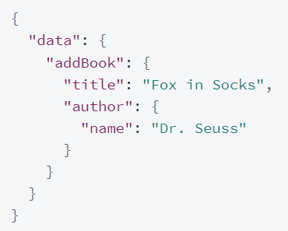
GraphQL Schema (SDL)
Structuring a mutation
Like queries, mutations match the structure of your schema's type definitions. The following mutation creates a new Book and requests certain fields of the created object as a return value:

Slide 18
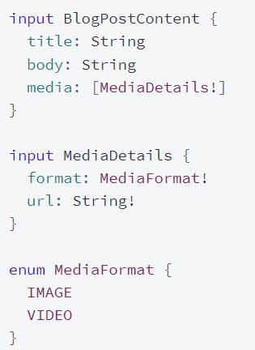
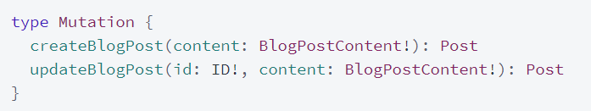
GraphQL Schema (SDL)
Input types
Input types are special object types that allow you to provide hierarchical data as arguments to fields (as opposed to providing only flat scalar arguments).

Slide 19
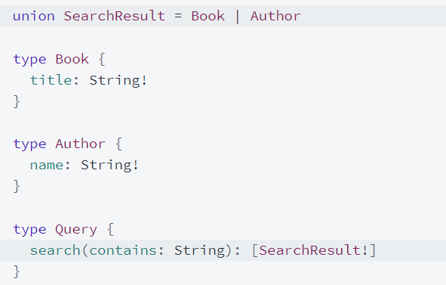
GraphQL Schema (SDL)
Union type
A field can have a union (or a list of that union) as its return type.
Can return any object type that's included in the union

Slide 20
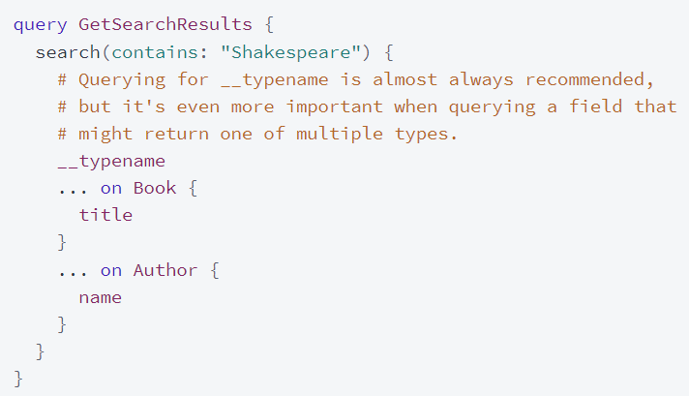
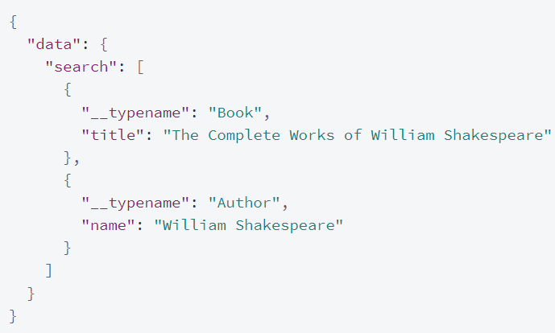
GraphQL Schema (SDL)
Union Type: Querying a union

Slide 21
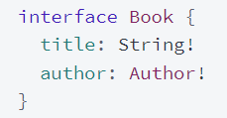
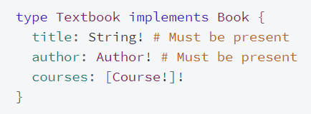

GraphQL Schema (SDL)
Interface type
An interface specifies a set of fields that multiple object types can include:

Slide 22
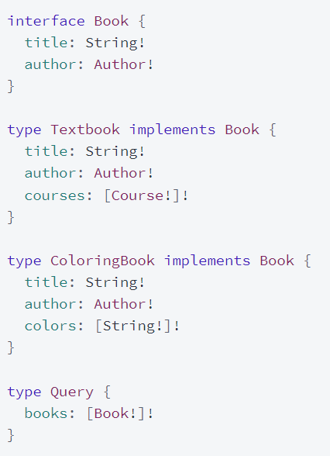
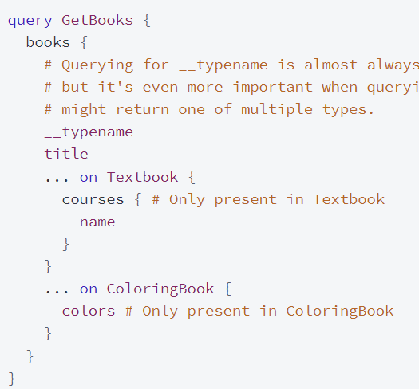
GraphQL Schema (SDL): Querying an interface

Slide 23
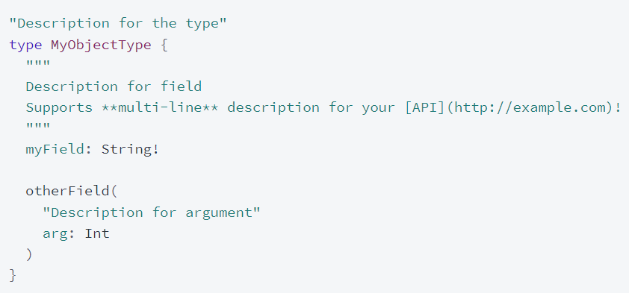
GraphQL Schema (SDL)
Descriptions (docstrings)
GraphQL's schema definition language (SDL) supports Markdown-enabled documentation strings, called descriptions.
These help consumers of your graph discover fields and learn how to use them.

Slide 24
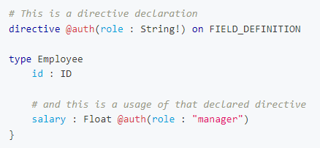
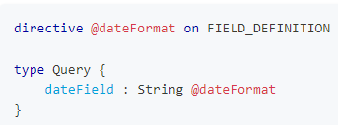
Schema Directives
A directive decorates part of a GraphQL schema or operation with additional configuration.
The valid SDL directive locations are as follows :
SCHEMA,
SCALAR,
OBJECT,
FIELD_DEFINITION,
ARGUMENT_DEFINITION,
INTERFACE,
UNION,
ENUM,
ENUM_VALUE,
INPUT_OBJECT,
INPUT_FIELD_DEFINITION

Slide 25
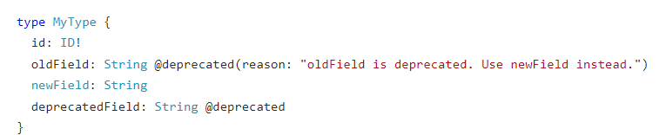
Schema Directives
Built-in Directives
@skip
@include
@deprecated
@specifiedBy

Slide 26
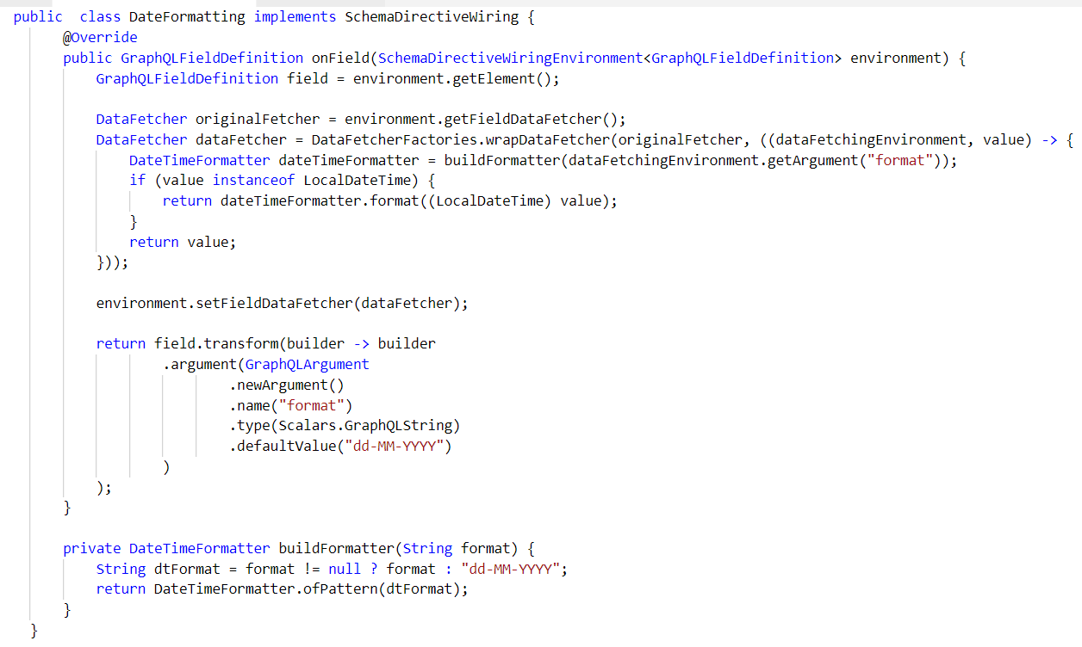
Schema Directives: Wiring the code

